Slide 1


SAP UI5 & FIORI with OData TRAINING
Anubhav Oberoy & Shekhar Vedi
Day – 11

Slide 2

Agenda – Day 11
Implement Create Method for the Product Set
Testing the Create Method in the SAP Gatway Client
Implementing the Update and Delete Methods.
Introduction to the Postman Tool
Understanding how to test Odata Api’s using Postman
Introduction to X-CSRF token
Creating Supplier Entity
Introduction to Association in Odata
Creating OrderItem Entity
Creating Association in Odata
Function Import

Slide 3
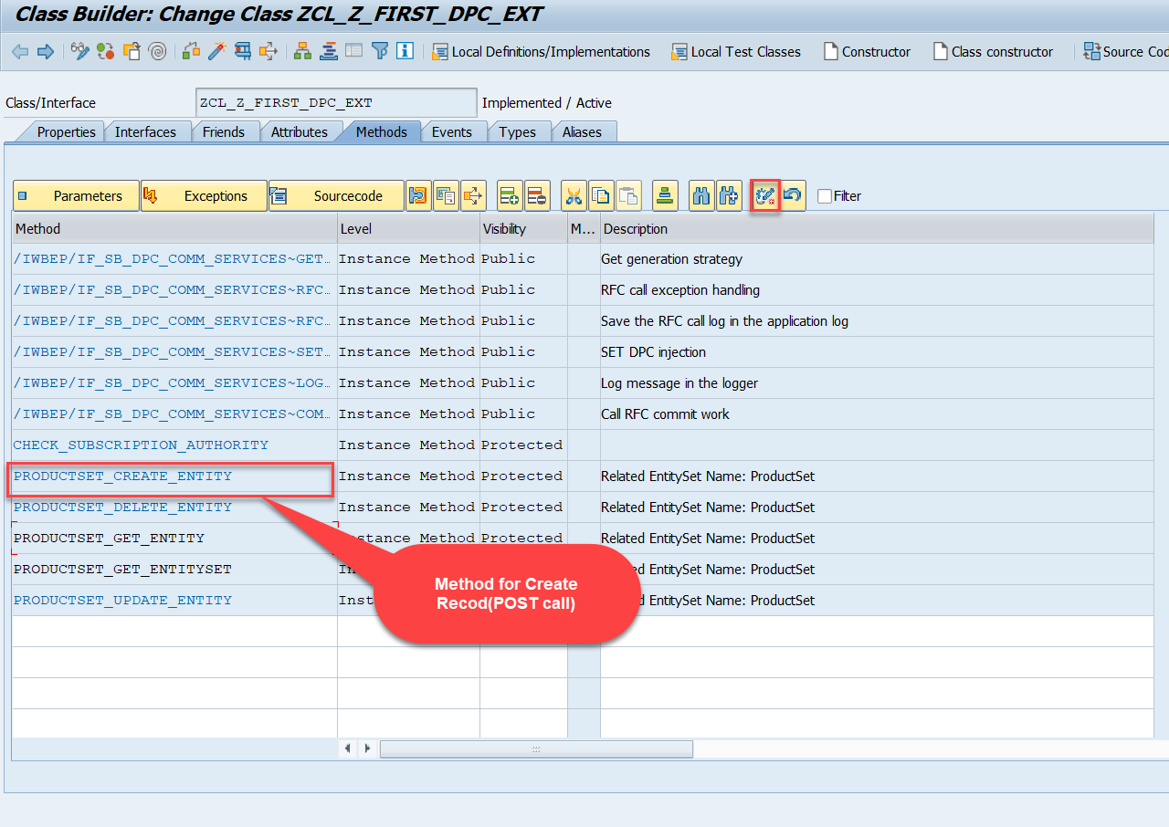
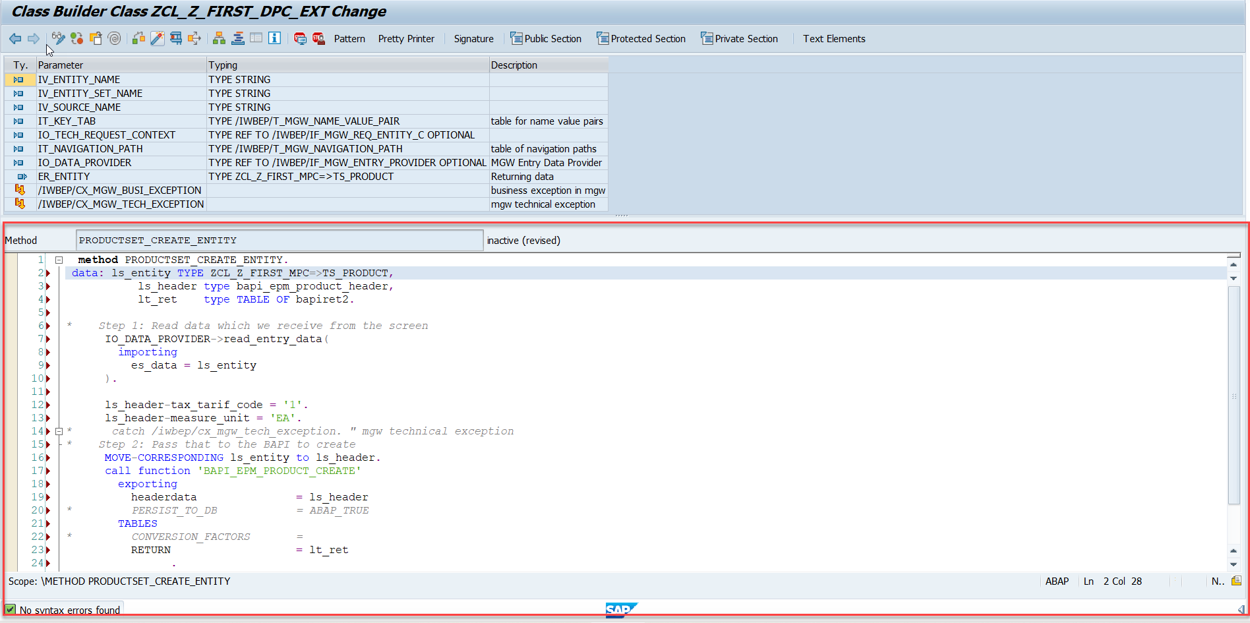
Building CreateEntity(POST) Method
Go to DPC Extension of over service and redefine the method PRODUCTSET_CREATE_ENTITY
Code: CreateProductEntity

Slide 4
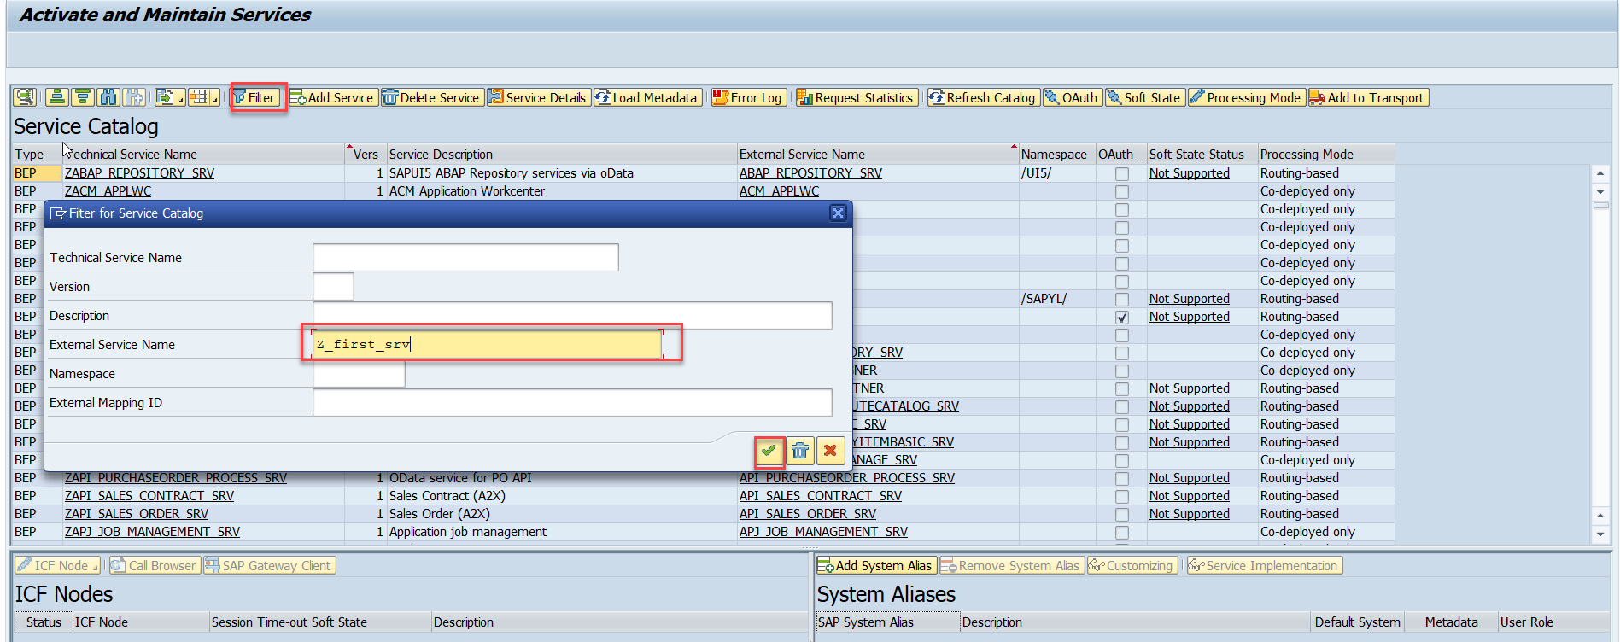
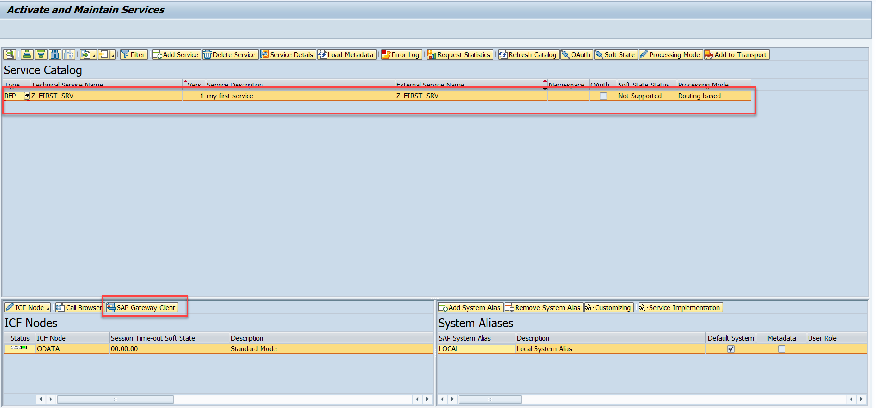
Testing Create Method at Sap Gateway client
Step:1 Go to sap service maintance(tcode- /iwfnd/maint_service) and search for the service and then select the service and click on the sap gateway client

Slide 5
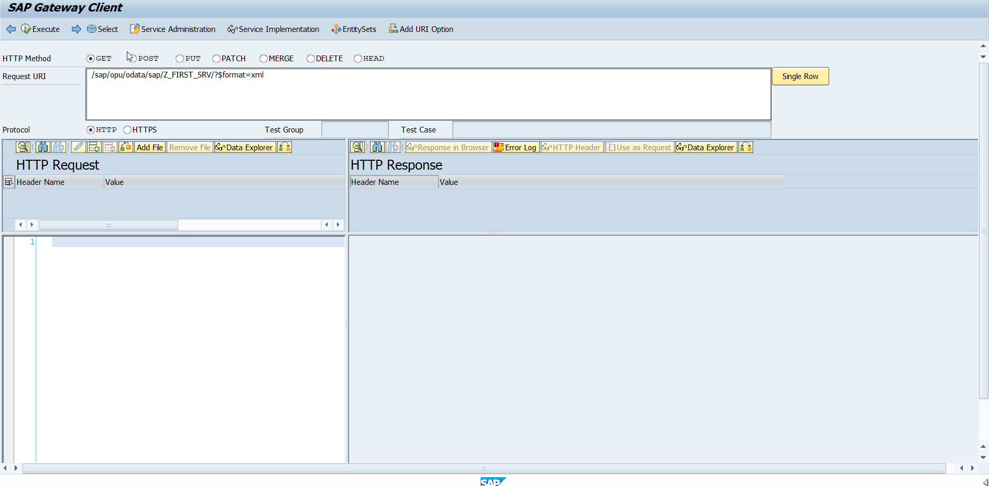
Testing Create Method Continue…
Step:2 Go to sap service maintance(tcode- /iwfnd/maint_service) and search for the service and then select the service and click on the sap gateway client

Slide 6
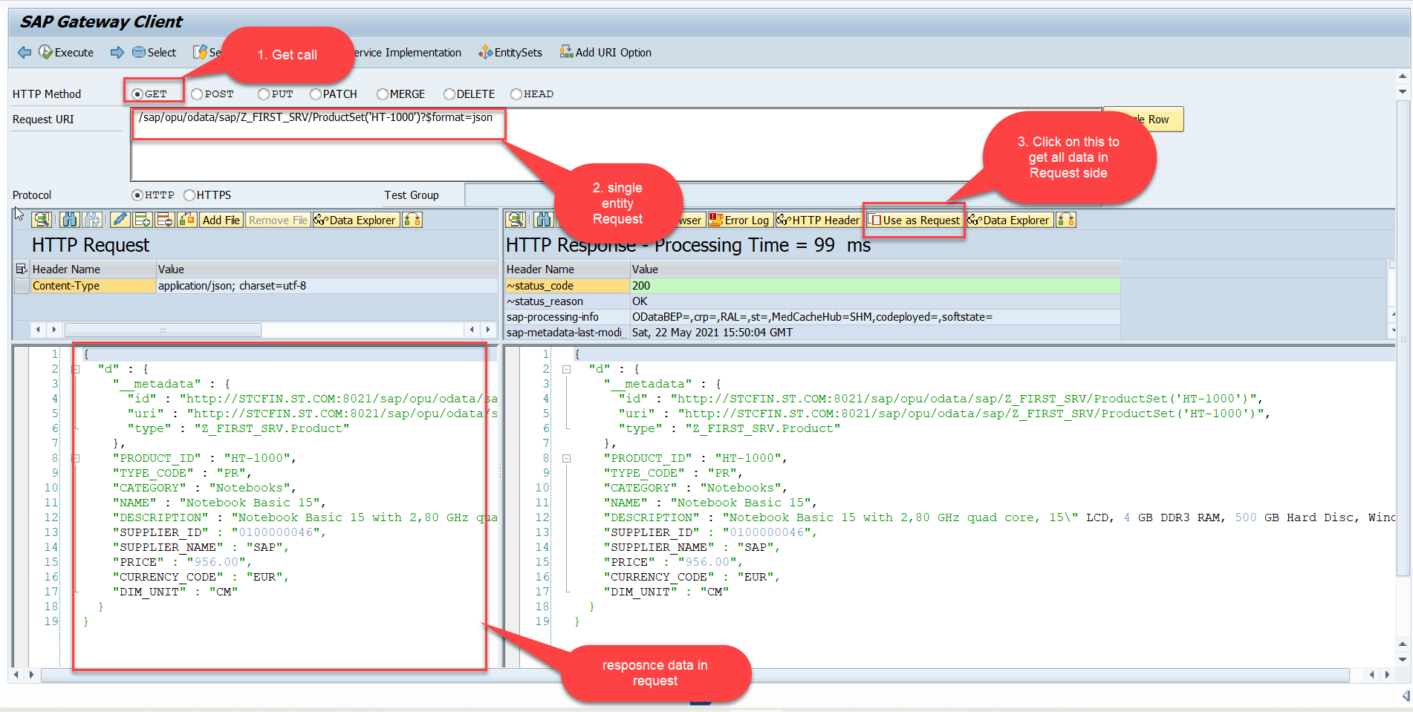
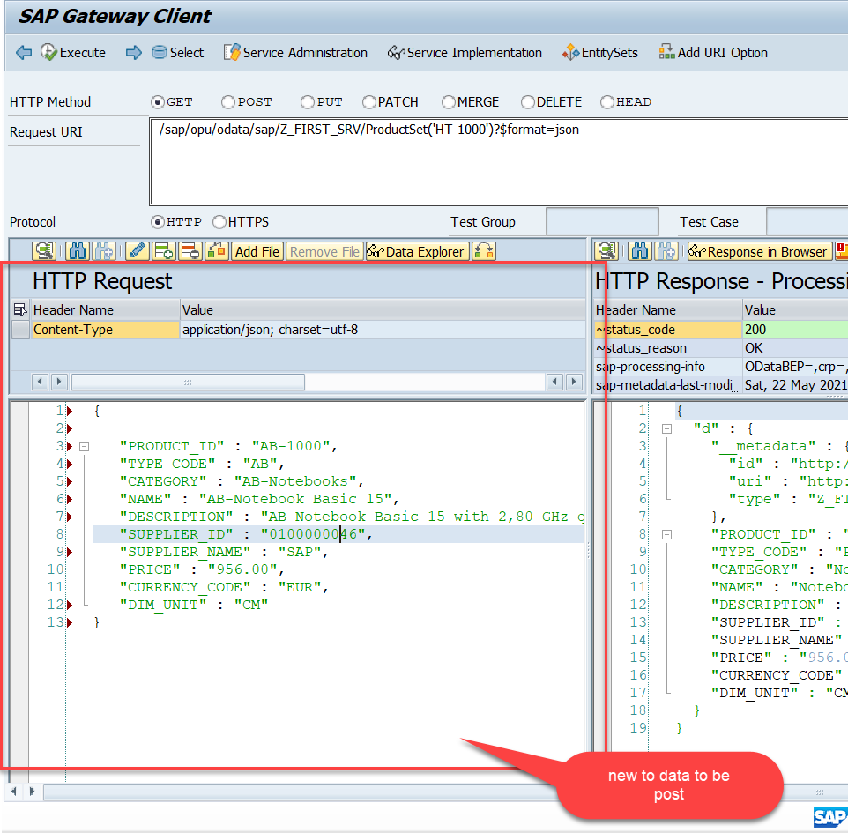
Testing Create Method Continue…
Step:3 Perform a getEntity in the Product set to get the payload to post (/sap/opu/odata/sap/Z_FIRST_SRV/ProductSet('HT-1000')?$format=json) and then clean the data and modify the payload as new.

Slide 7
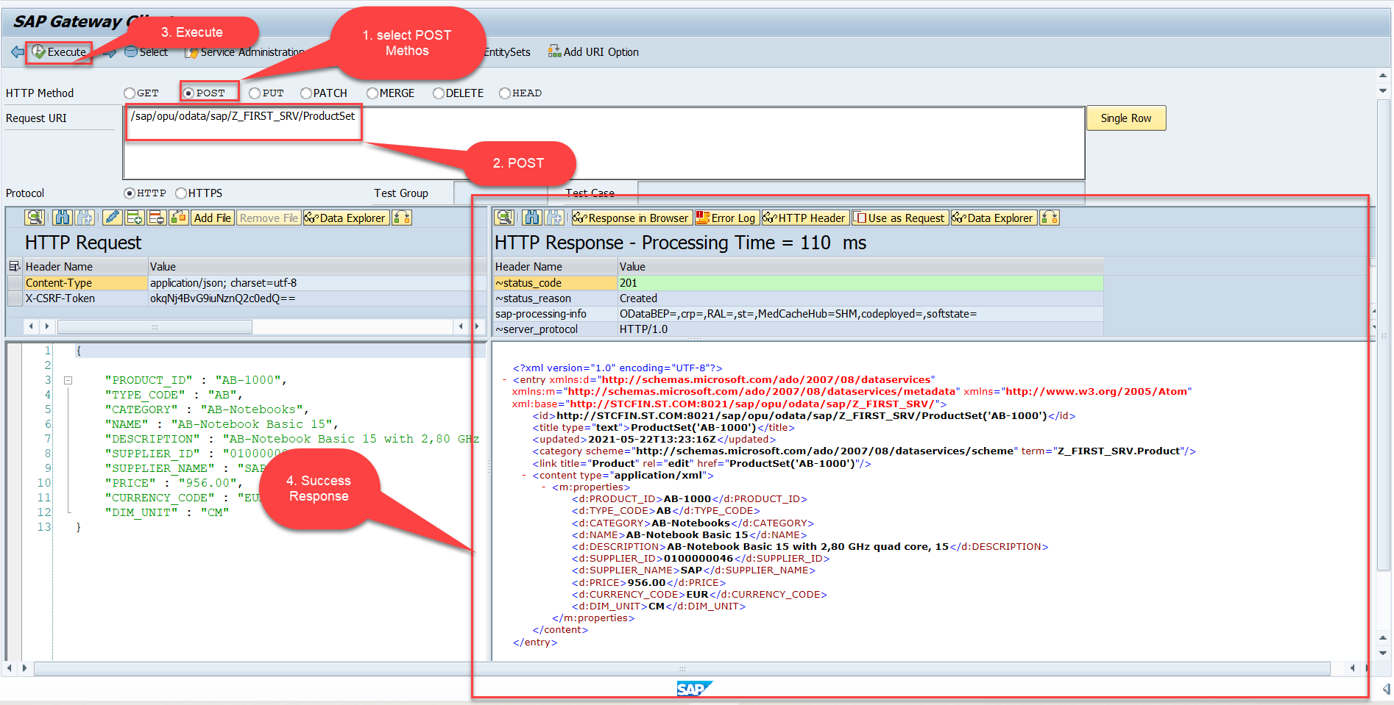
Testing Create Method Continue…
Step:4 send the post request at (/sap/opu/odata/sap/Z_FIRST_SRV/ProductSet)

Slide 8
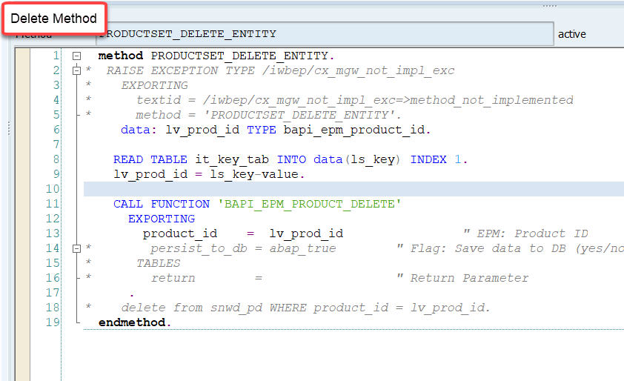
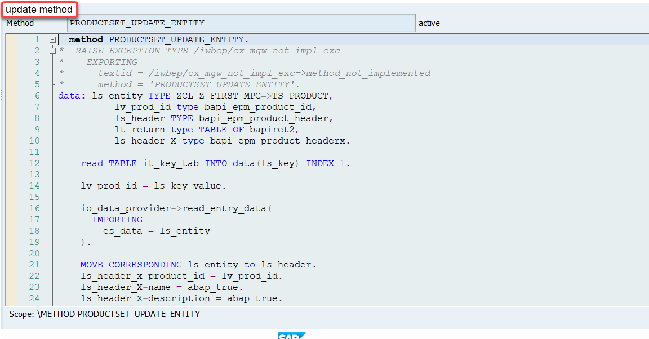
Implementing DELETE and Update (PUT) method
We can implement the delete and update method in the corresponding DPC extension classes.
Code: ProductSetDeleteEntity
Code: ProductSetUpdateEntity

Slide 9

Introduction to POSTMAN Tool
Postman is an API platform for building and using APIs. Postman simplifies each step of the API lifecycle and streamlines collaboration so you can create better APIs—faster.
It is an interactive and automatic tool for verifying the APIs of your project.
It presents you with a friendly GUI for constructing requests and reading responses. ... Postman is the way to streamline the process of API testing.
Postman can run GET, POST, PUT, PATCH, MERGE, DELETE, and various other request methods as well, and has utilities to help with developing APIs. Free and paid versions are available for Mac, Windows, Linux, and as a Chrome app.
You can Download the postman tool from the link give below:
https://www.postman.com/downloads/

Slide 10
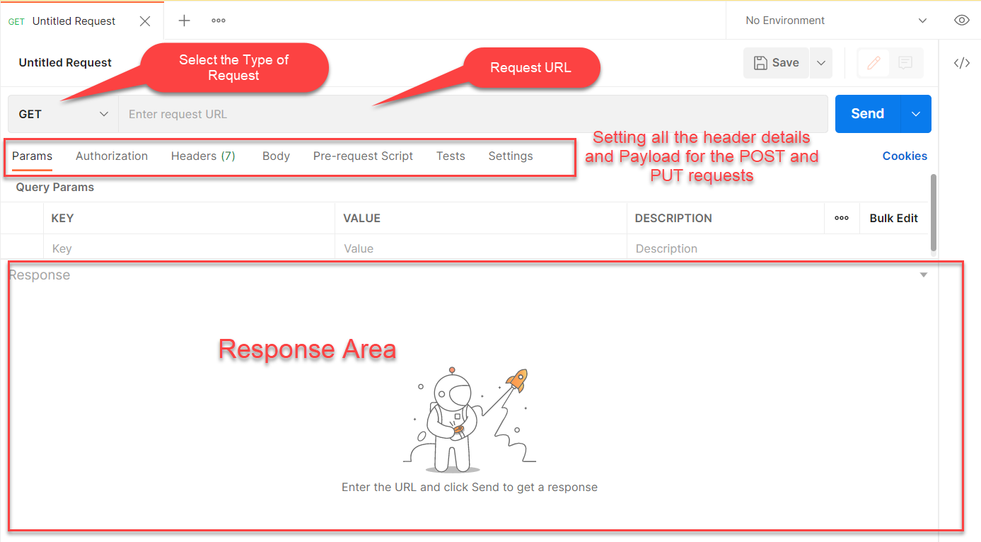
Postman App Layout
The below screen shot shows a basic layout of a request in Postman

Slide 11
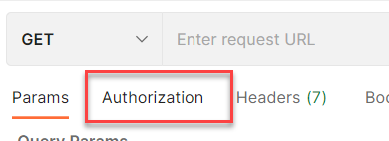
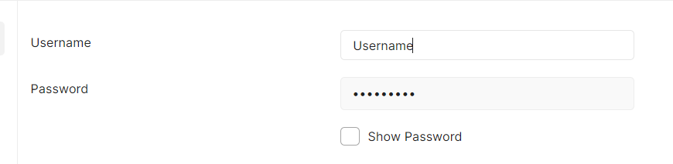
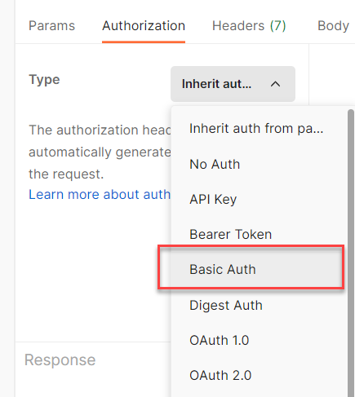
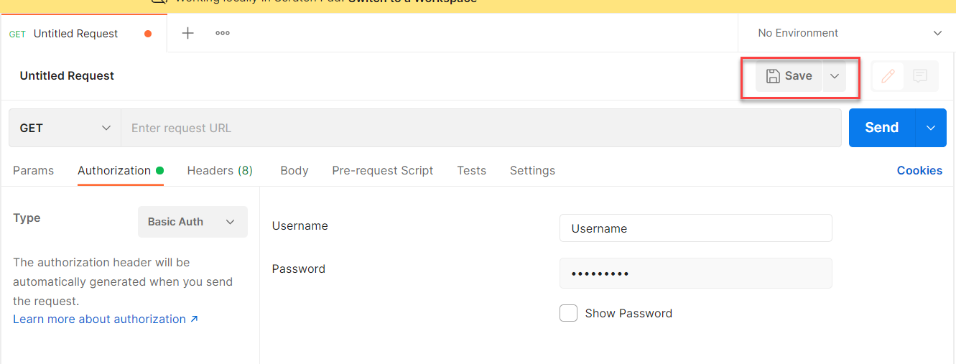
Setting Basic Auth in Postman
Step 1: Go to the Authorization section.
Step 3: Set the Username and Password.
Step 2: Select Basic Auth as Type
Step 4: Save.

Slide 12
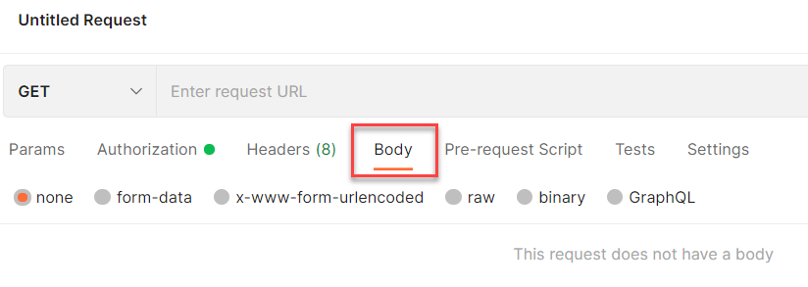
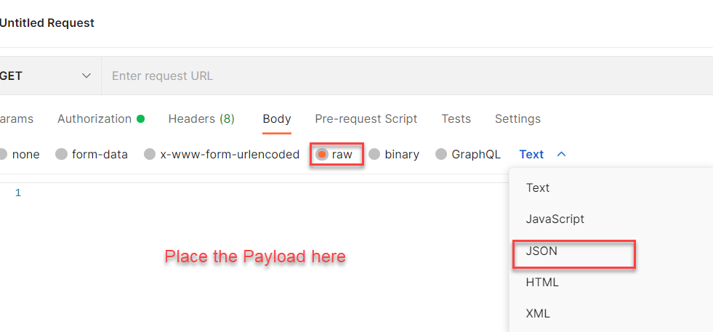
Setting the Payload for POST and PUT request
Step 1: Go to Body Section.
Step 2: Select the raw option form the radio button and then select the data type as JSON.

Slide 13
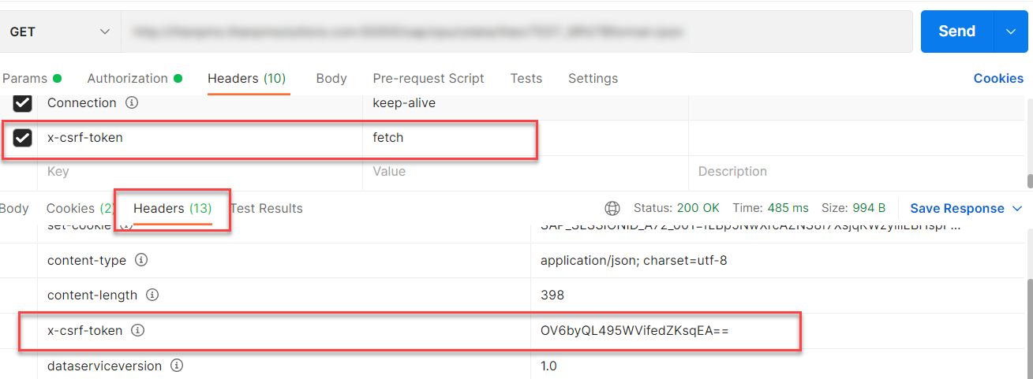
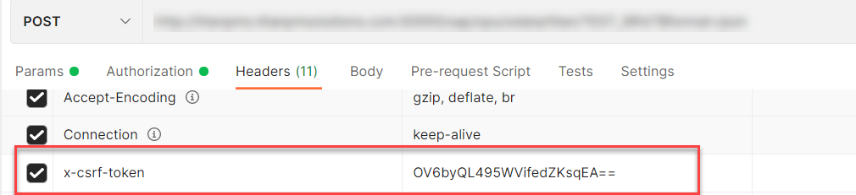
X-CSRF Token
A CSRF Token is a secret, unique and unpredictable value a server-side application generates in order to protect CSRF vulnerable resources.
The tokens are generated and submitted by the server-side application in a subsequent HTTP request made by the client.
Steps to Get the x-csrf token.
To get the x-csrf token we need to pass the value of x-csrf token as fetch with the GET call.
After executing the get call we will find the token in the Header Section of the Response.
- In POST call we need to pass this value of x-csrf token in the header section.

Slide 14
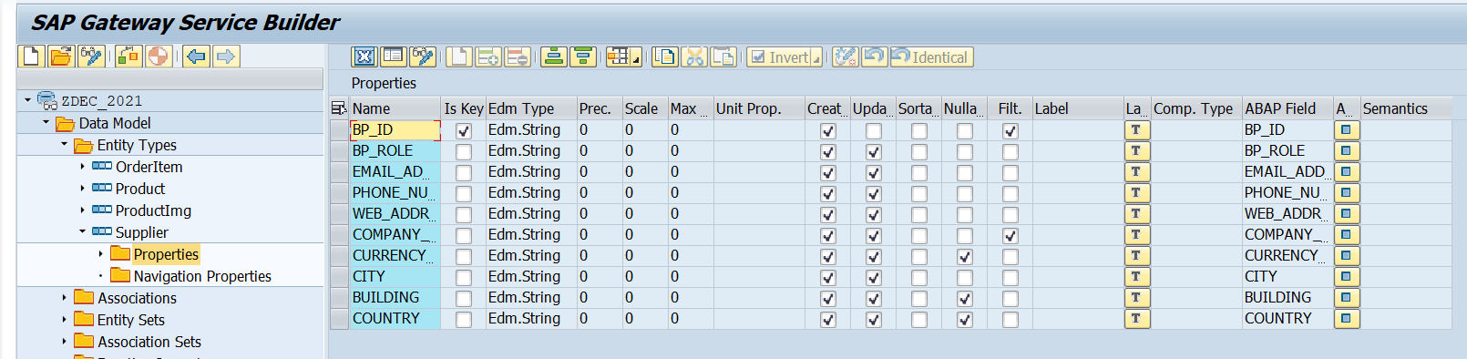
Create Supplier Set
Create a Supplier Set in the Entity Type Section by following the steps used to create Product Set.
Supplier Set
Once the Entity sets are created, we can also implement the Get Entity for of Supplier Set in the same way as we have created for the Product Set.
Code to Create Supplier Set Get Entity
SupplierSetGetEntity

Slide 15
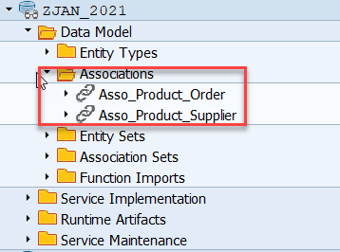
Association
Associations are relationship Between entities.
At database level we have foreign key relationship and same is reflected at odata level.
Once a association is created only then we can create navigation property.
Product
Supplier
1 relation 1
nav

Slide 16
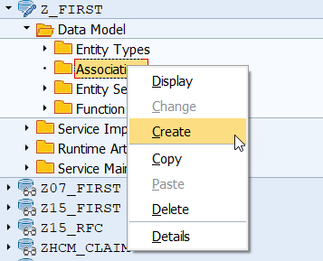
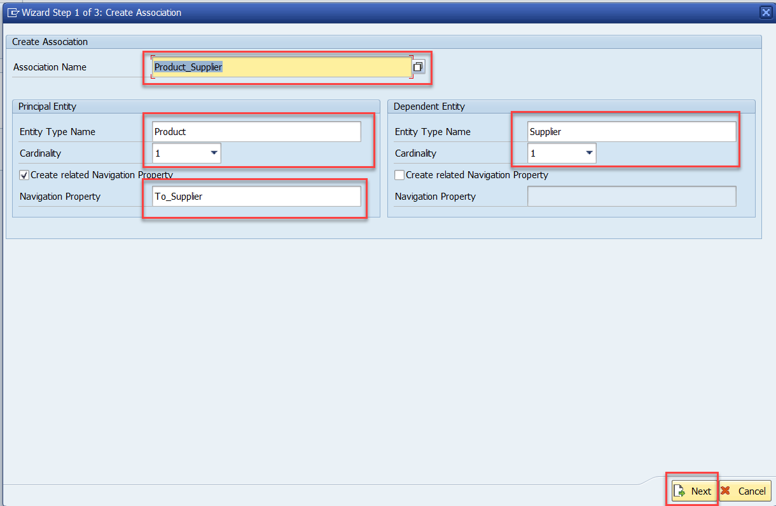
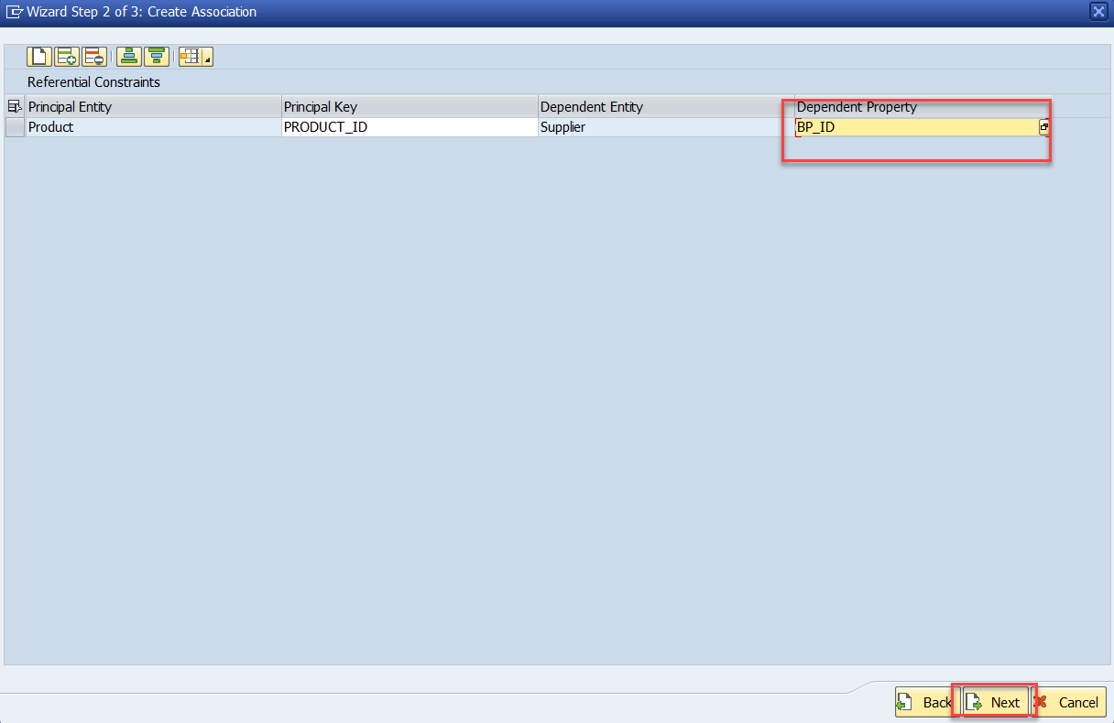
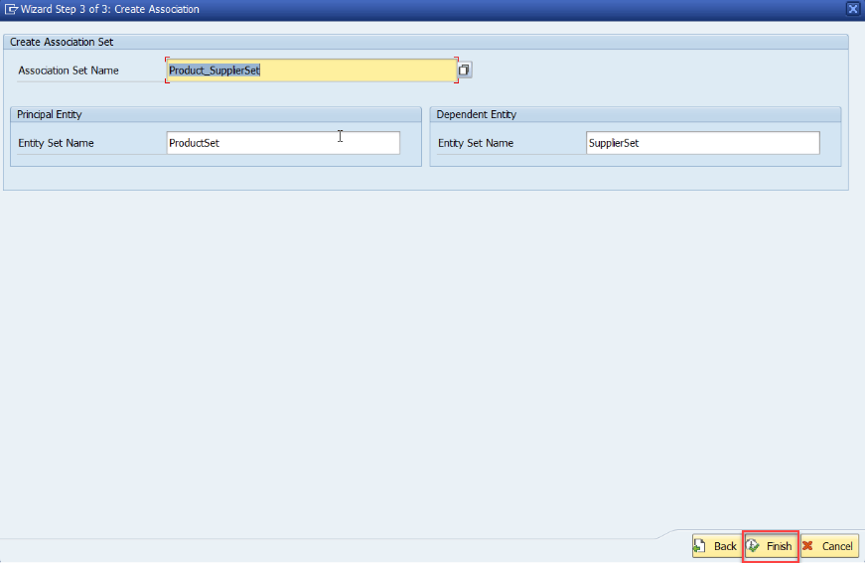
Association (1:1)
Step:1 Right Click on Association and click on create
After creating the Association for Supplier Set in Product Set, we need to change the Supplier Get entity.
SUPPLIER_GET_ENTITY

Slide 17
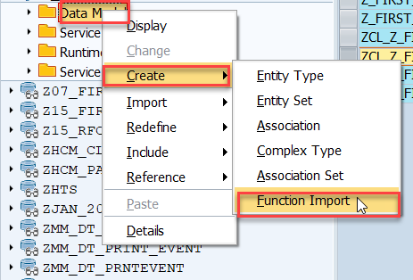
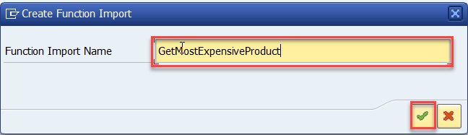
Function Import
At times, we need to implement the logic inside of OData which is not a direct CRUD operation e.g. calling a workflow, calling a BAPI which does some processing, Sending request to another server and can be invoked by the HTTP methods GET or POST .
For example: we can create the function import to GetMostExpensiveProduct in our Product set by the Category.
Step1: Right click the Data Model folder and select Create and then select Function Import. Create Function Import dialog opens

Slide 18
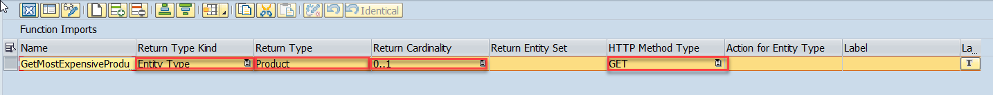
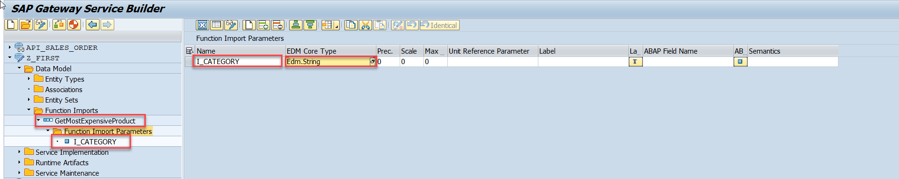
Function Import
Step2: Enter return type kind, return type, return cardinality & HTTP method Type
Step3: Giving function import parameters (I_CATEGORY)

Slide 19
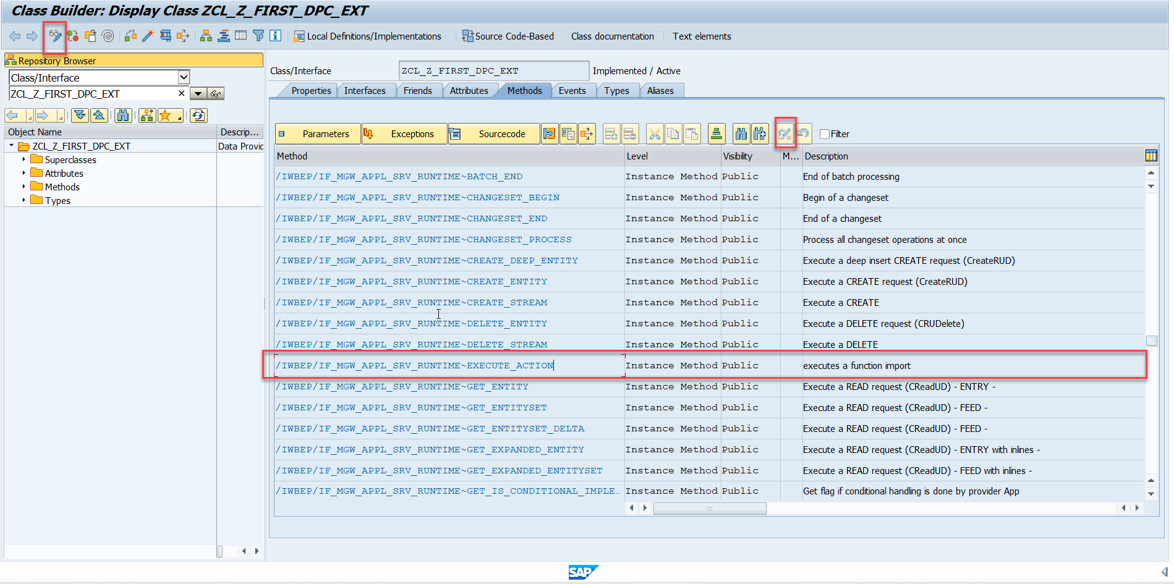
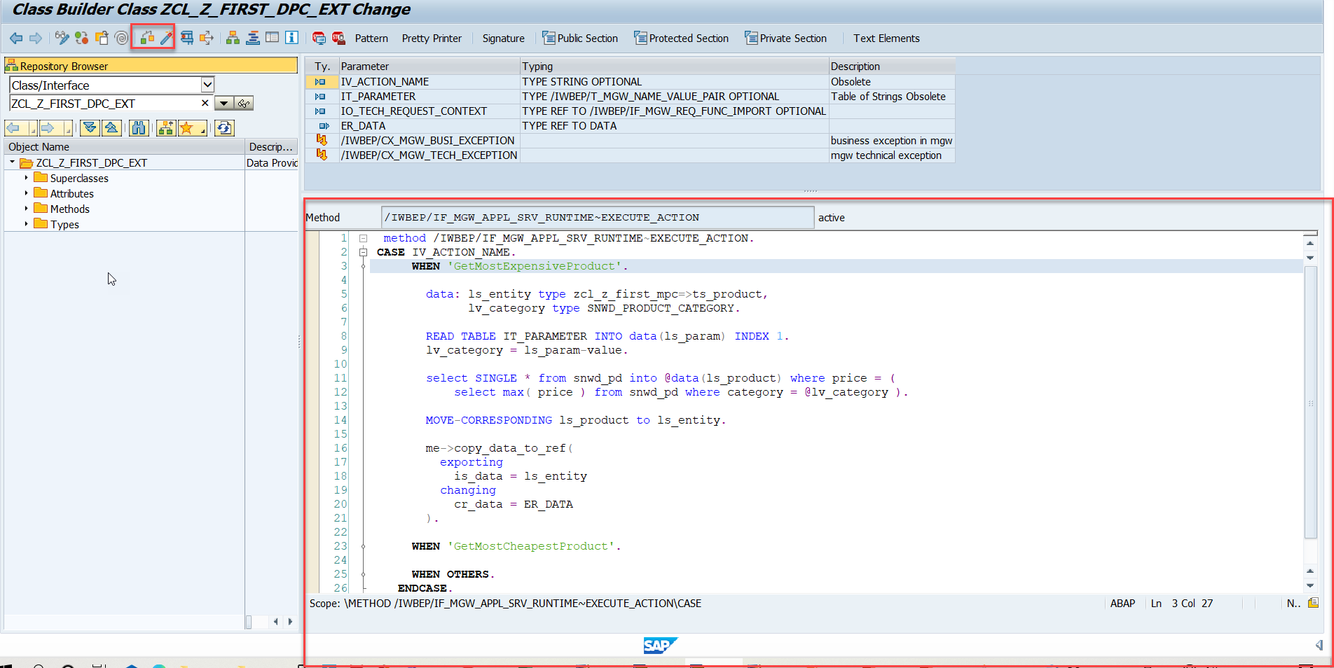
Function Import
Step4: Go to DPC Extension and search for the method--/IWBEP/IF_MGW_APPL_SRV_RUNTIME~EXECUTE_ACTION and redefine the class method
Function Import Code: funciton_import

Slide 20

End of Day 11

Slide 21

Questions

Slide 22

Anubhav Oberoy

Slide 23


We’re committed to empower you to be
Most Desirable Resource
through powerful training solutions.
We build the workforce of the future.
250+
Corporate Clients
30,000+
Learners Trained
25000+
Learners Placed
FREE WEBINARS
Sign up for free webinars with industry experts every fortnight!
Enroll Now!
Contact us today!
https://anubhavtrainings.com/

Slide 24




More from AnubhavTrainings.com

Slide 25
Title
Content

